Slide 1
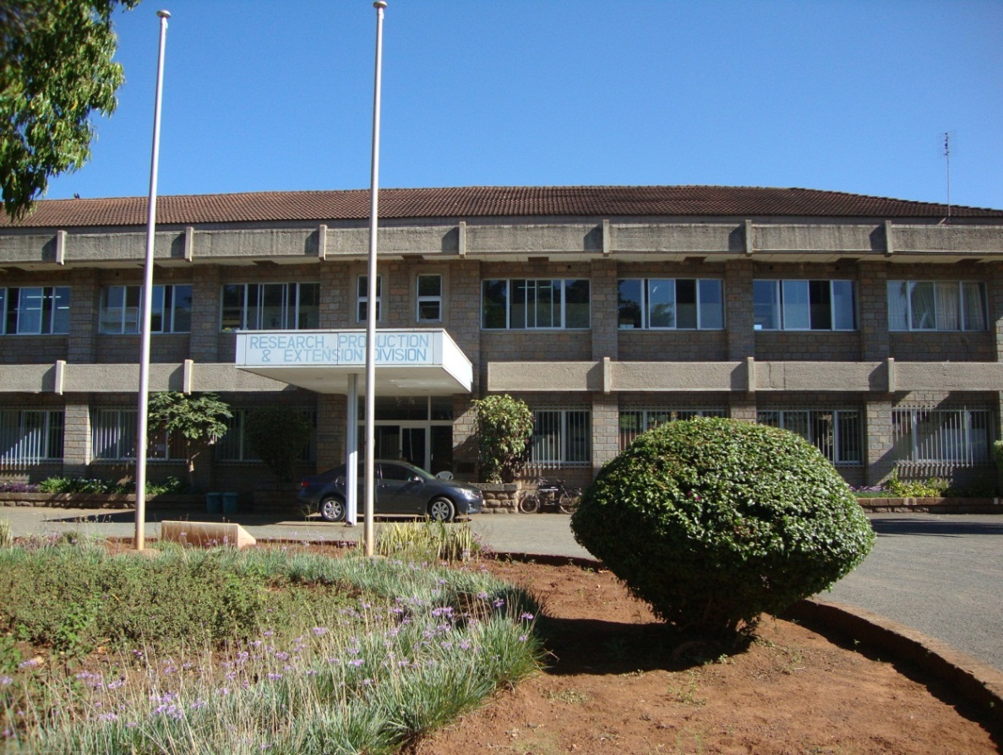

RESEARCH, PRODUCTION AND
EXTENSION - JKUAT
Prof. Esther Murugi KAHANGI, DVC RPE, JKUAT

Slide 2
GRANTS;
PRESENTATION OUTLINE :
INTRODUCTION;
JKUAT RPE DIVISION;
RESEARCH THEMES;
INSTITUTES AND CENTRES;
EXTENSION, TECH EXPO., LINKAGES;
CONCLUSIONS & FUTURE.

Slide 3
INTRODUCTION
In knowledge-based economies, universities have become key elements of innovation systems both as human capital providers and as seedbeds of new businesses.
Developed countries are now focusing on the potential of the universities in enhancing innovation environments and creating a regime of science based economic development.
One way for universities to become entrepreneurial is by commercializing research outputs.

Slide 4
HISTORY OF UNIVERSITY RESEARCH
Drawing on experience of US research oriented universities, we find that:
Prior to world war II, universities undertook research for academic advancement without regard to its use in societal improvement
After world war II and on the basis of the 1945 report by Vannevar Bush “Science, The Endless Frontier”, the US government decided to support research on the following basis:
    Support of basic science, and Industry’s focused on applied research
    Though patents increased in number, they were owned by government and few were ever commercialised.

Slide 5
HISTORY OF UNIVERSITY RESEARCH
  The enactment of the Bayh-Dole Act (Patent and Trademark Amendments of 1980) invigorated the technology transfer process from universities and federal laboratories to business and industry
    Universities now benefit as they co-own patents with researchers/innovators
    Private sector could commercialise patents/innovations
    Country benefits from economic growth arising from new jobs, new streams of income and increased competitiveness in international markets.

Slide 6
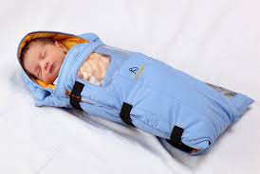
HISTORY OF UNIVERSITY RESEARCH- THE CASE OF STANFORD
Outcomes of technology transfer (US)
  over the years universities have become entrepreneurial creating many Jobs through commercialization of innovations
  Stanford university currently generate 3 million jobs annually worth USD 2.1 trillion
StanFord innovative Warmers to Reduce Infant Mortality

Slide 7
THE INNOVATION PROCESS
Capital, equipment, scientists
h
INPUTS
Customer feedback
Market research
Policy
Needs driven Research
SOCIO-ECONOMIC BENEFIT
RESERCH AND DEVELOPMENT
PRODUCT DEVELOPMENT
DISSEMINATION
Societal driven research

Slide 8
THE JKUAT RPE DIVISION
The RPE division is in charge of management and administration of all research, innovation, technology transfer and collaboration activities in JKUAT. The division was established by JKUAT Act 1994.
The main objectives of the division are:
To play an effective role in the development of Agriculture and Technology in conjunction with industry;
To provide extension services to contribute to the social and economic development of Kenya.
It is commendable that the drafters of this Act clearly appreciated the emerging importance of research units in modern HEIs.

Slide 9
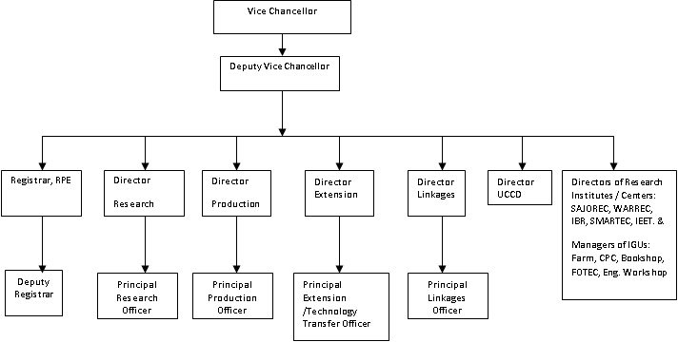
RPE GOVERNANCE STRUCTURE

Slide 10
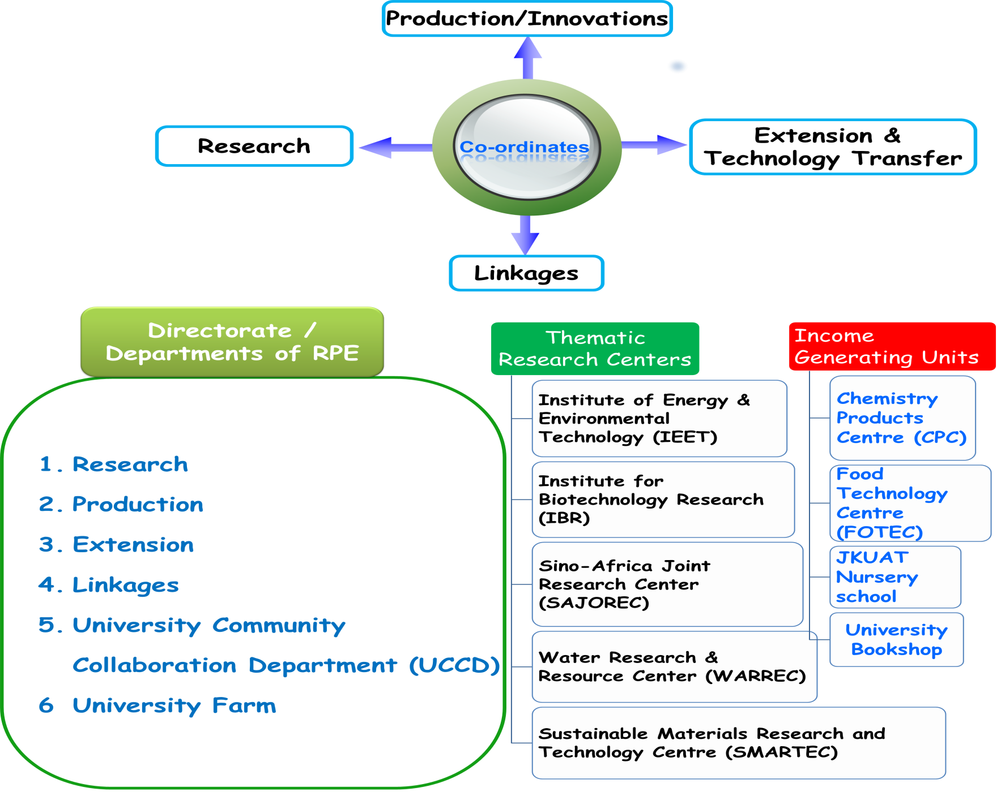
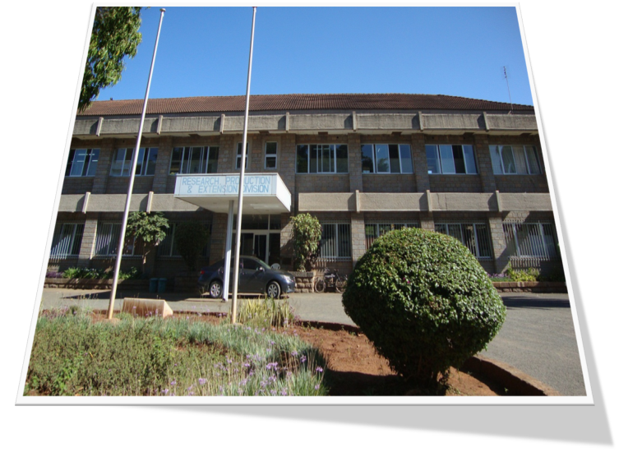
JKUAT RPE DIVISION

Slide 11
ROLE OF RPE DIVISION
RESEARCH
PRODUCTION
EXTENSION
LINKAGES
Manage all Research activities
Up-scaling and commercialization
Tech Transfer
University partnerships
exhibitions
Policy,
trainings
Proposal& M&E
incubation
MOUs
&MOAs
Piloting innovation
Fund raise
Database
Fund Raise
Fund raise
IGUs
Value chains
analysis
policy
M&E
policy
policy
Conferences and publications
Impacts/social studies
Media
programs
M&E
Administer Internal Funds

Slide 12
GRANTS
JKUAT Grants grew exponentially in terms of funding levels in the last ten years. There are three main sources of research funds in the university namely, JKUAT, Government of Kenya (through NACOSTI) and more recently the National Research Fund (NRF), and other local and external international donors. The innovation projects are mainly funded by JKUAT.
JKUAT, Cumulative research funding (2005 to 2016
JKUAT, Cumulative Innovation funding (2008 to 2016).

Slide 13
GRANTS
NACOSTI, Cumulative research funding (2005 to 2016).
International donor, Cumulative research funding (2005 to 2016)

Slide 15
JKUAT RESEARCH THEMES
Agric and Food Security
Social Science
Engineering Tech & Industrial Development
Built Environment
ICT
Human and Animal Health
Natural products
Water Resources
Nanotechnology

Slide 16
JKUAT CENTRE OF EXCELLENCE
IBR
SMARTEC
Food Security
(Legume, fortification)
IEET
WARREC
SINO AFRICA

Slide 17
Distribution of Research funding per theme

Slide 18
Food Security Theme (KES: 1.086 b)
Sub-theme 1
Sub-theme 2
Sub-theme 3
Sub-theme 4
Crop Production and Management
Postharvest
and
Value Addition
Nutrition
and
Health
Insects for food and feed
Seeds
/Seed-lings
Water/ Nutrient
Food fortifica-tion
Nutrient Bio-availa-bility
Processing
Postharvest
Technology
Production
Formulation
Pests/
Diseases
Food Safety
Plant
Nutrition
Biowaste utilization
Genomics
Functional foods
Human food and safety
Packaging
Feed analysis

Slide 19
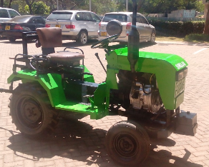
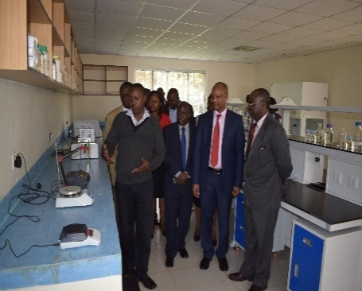
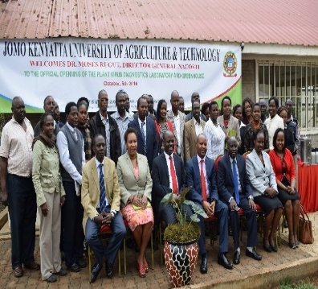
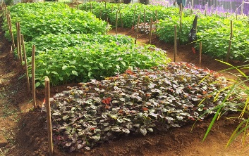
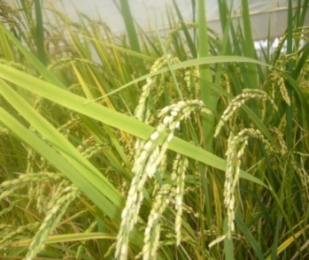
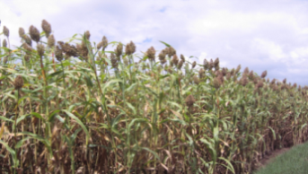
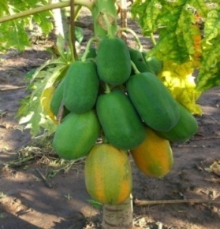
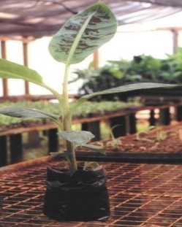
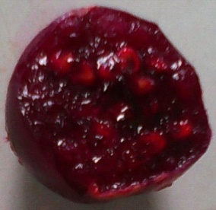
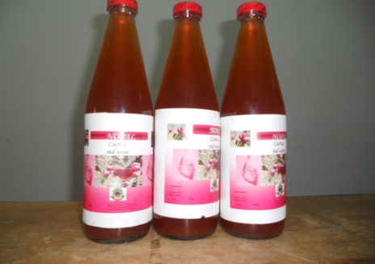
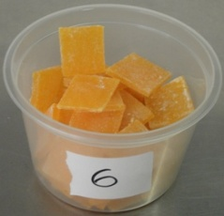
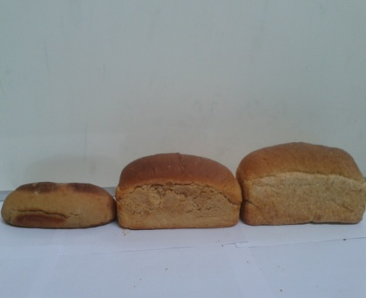
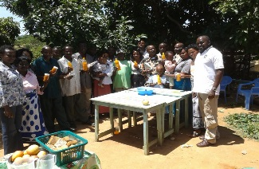
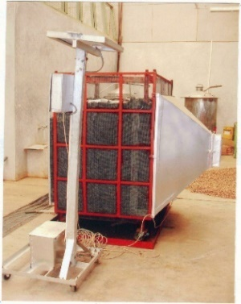
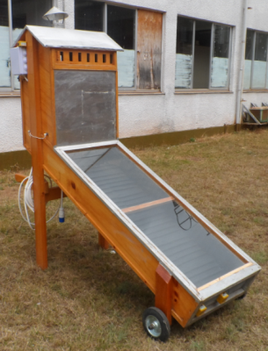
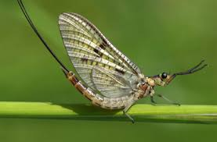

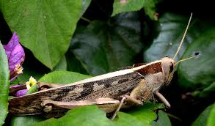
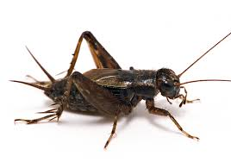
Capacity building | Quantity
Post-doctoral students | 4
PhD. | 40
MSc. | 21
BSc. | 14
Technicians | 4
Internships | 2
Total | 85
Other Key Performance Indicators | Quantity
Publications in peer reviewed journal and conference proceedings | 113
Number of products developed | 17
Projects qualifying for patent/ plant breeders rights | 4
Infrastructure developed | 7
Technology development | 2
PRODUCTS

Slide 20
RESEARCH THEME: ENGINEERING AND TECHNOLOGY (199 m)
Sub-theme 2
Sub-theme 3
Sub-theme 1
Industrial and Agricultural Machineries and Processes
Sustainable Transport Vehicles and Systems
Infrastructure and Environmental Challenges
Agro-machinery
Fuels and Energy
Pollution and Control
Construction Materials
Industrial Machinery
Materials
Machine tools
Communication and Navigation
Energy Resource Utilization
Emerging cross-cutting technologies
Mechanics
Power Generation and Transmission

Slide 21
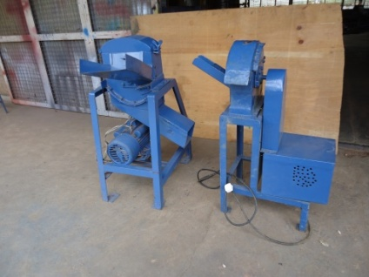
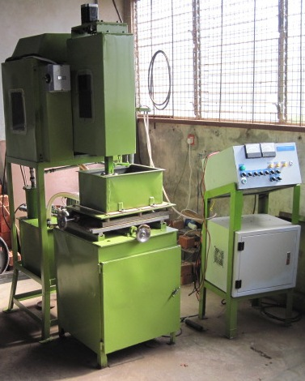
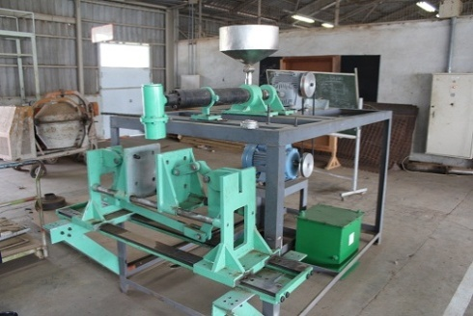

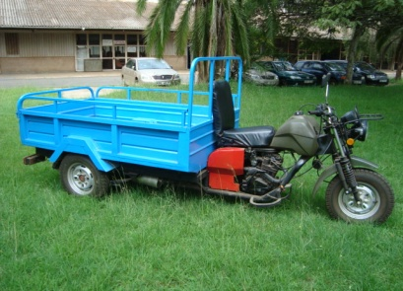
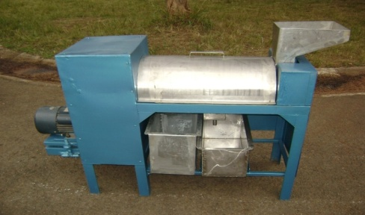
KEY PERFORMANCE INIDCATORS AND PRODUCTS
KEY PERFORMANCE INIDCATORS AND PRODUCTS
Capacity Building
No. of PhDs | 3
No. of. MSc | 15
No. of Technicians Trained | 10
No. of Internships | 8
Total | 36
Other Key Performance Indicators
No. of Publication in peer reviewed journals and conference proceedings |  | 50
No. of Products developed |  | 12
No. of Products filed for patents |  | 3
Infrastructure developed/maintained |  | 10
Technology development |  | 5
Plant mills
Electrical Discharge Machine
Blow molding machine
Reinforced earth block
Tricycle with carrier
Fruit pulper

Slide 22
Natural Products Theme (KES: 66.3 m)
Sub-theme 1
Sub-theme 2
Sub-theme 3
Sub-theme 4
HUMAN DISEASES
ANIMAL DISEASES
INDUSTRIAL
PRODUCTS
FOOD PRESERVATION AND PRO-BIOTICS
MALARIA
BEAUTY PRODUCTS
HERBS
GASTRO-INTESTINAL
HELMINTH
BIO_FUELS
HIV
BILHAZIA
ENZYMES
BIO-CULTURE
TOXICOLOGY

Slide 23

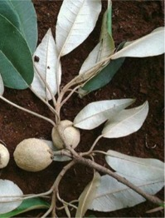
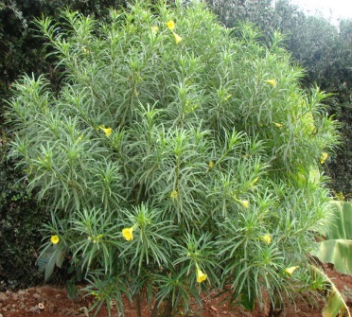
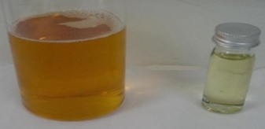
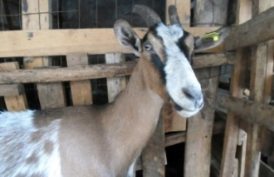
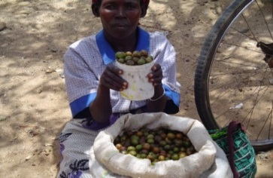
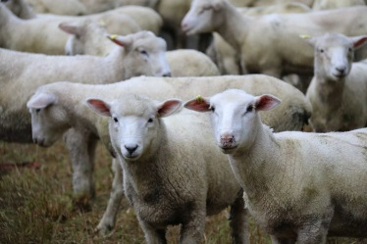
Capacity building | Quantity
Post-doctoral students | 0
PhD. | 7
MSc. | 11
BSc. | 17
Technicians | 4
Internships | 2
Total | 36
Other Key Performance Indicators | Quantity
Publications in peer reviewed journal and conference proceedings | 39
Number of products developed | 9
Product qualifying for patent | 2
Technology development | Yes
PRODUCTS

Slide 24
HUMAN AND ANIMAL HEALTH (KES:118.6 m)
Sub-theme 1
Sub-theme 2
Human Health
Animal Health
CANCER
ZOONOTIC
TB
HELMINTHS
SLEEPING SICKNESS
HIV
MALARIA
ECF

Slide 25
Capacity building | Quantity
PhD. | 5
MSc. | 20
BSc. | 2
Other Key Performance Indicators | Quantity
Publications in peer reviewed journal and conference proceedings | 14
Number of products developed | 9
Product qualifying for patent | 6
PRODUCTS
Biomarker for late staging Sleeping sickness
LAMP test for diagnosis of Sleeping sickness.
A cyrobank for parasites (tacyzoites and bradyzoites.
Accurate method for establishing the safety of herbal preparations
Three drugs compounds for Malaria and three for Leishmanias (Patents applied for 4 & 5)

Slide 26
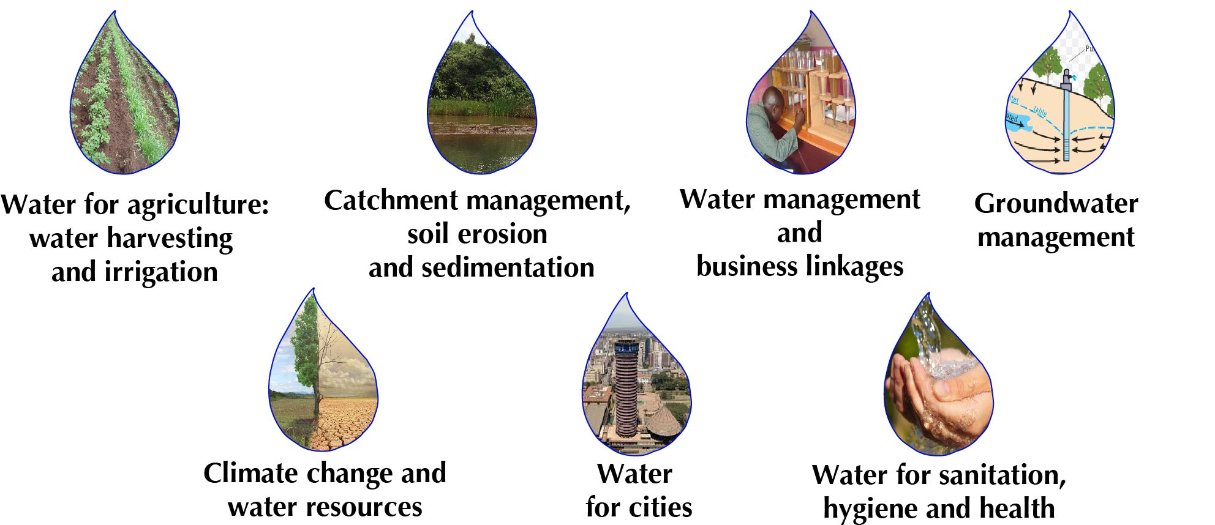
Water Resources Theme (KES: 34.2 m)

Slide 27
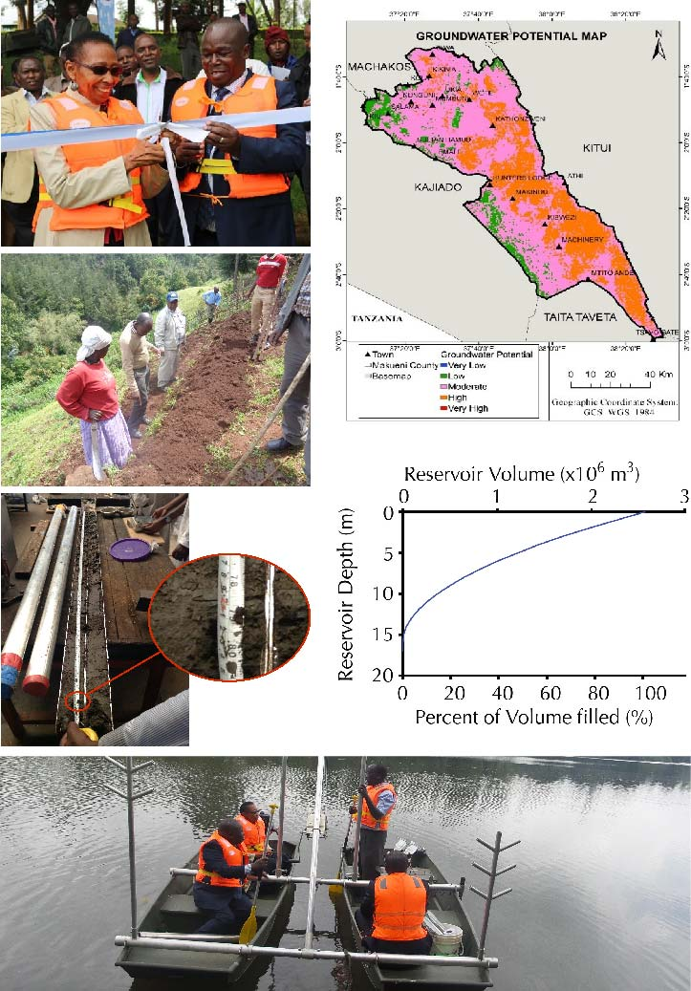
Capacity building | Quantity
Post-doctoral students | 7
PhD. | 16
MSc. | 76
BSc. | 45
Technicians | 12
Internships | 11
Other Key Performance Indicators | Quantity
Publications in peer reviewed journal and conference proceedings | 98
Number of products developed | 7
Technology development | 2

Slide 28
ENVIRONMENT AND INFRASTRUCTURE TECHNOLOGIES (94.4 m)
Sub-theme 1
Sub-theme 2
Sub-theme 3
Sub-theme 4
Sub-theme 5
Sub-theme 6
Energy efficiency building
Urban planning and design
Human settlements
Transport &
Infrastructure
Architectural pedagogy
Heritage
& conservation
energy audits
DATA BASE
Creation
Cultural heritage
SLUM upgrading
Enhance travellers safety
SUSTAINABLE
HOUSING

Slide 29
Capacity building | Quantity
PhD. | 3
MSc. | 18
Internships | 4
Total | 25
Other Key Performance Indicators | Quantity
Publications in peer reviewed journal and conference proceedings | 63
Number of products developed | 6
Consultancies | 6
PRODUCTS
Energy use in Buildings data base.
Urban planning, design and development data
Design-build curriculum (Training of trainers)
Students design prototype construction
Good school, good neighborhood handbook
Guidelines for achieving “good school, good neighborhood” model

Slide 30
ICT Theme (KES: 21.2 m)
Sub-theme 1
Sub-theme 2
Sub-theme 3
Internet of things, ubiquitous and robotics
Human computer interaction and cognitive computing
Big Data, cloud computing
Drones
robotics
Maize info. repository
PANCAKE
automation
Store room
GIS
DATA VIOSIONLIZATION

Slide 31
Capacity building | Quantity
Post-doctoral students | 1
PhD. | 9
MSc. | 4
Technicians | 1
Internships | 2
Total | 17
Other Key Performance Indicators | Quantity
Publications in peer reviewed journal and conference proceedings | 20
Number of products developed | 1
Technology development | 2
Maize information repository system
Mobile application for recording poultry data
Opportunities and Resources Portal for Kenyan University Students

Slide 32
NANOTECHNOLOGY (KES: 9.4 m )
Sub-theme 1
Sub-theme 2
Agriculture
Renewable Energy
Chemical residues
Fertilisers
Nano Structure Solar Cells
Pests/
Diseases

Slide 33
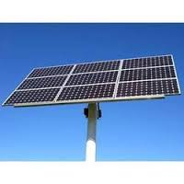
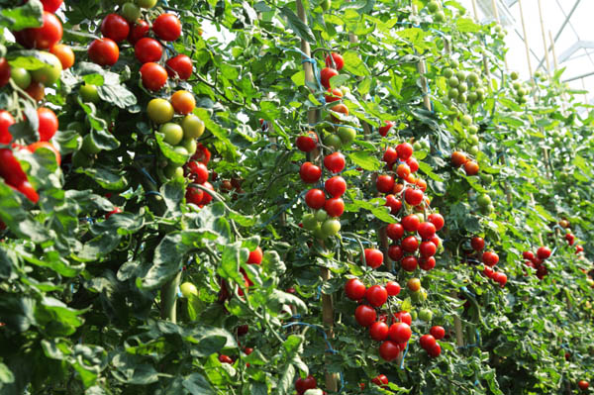
Capacity building | Quantity
PhD. | 3
MSc. | 5
BSc. | 1
Technicians | 1
Internships | 1
Total | 11
Other Key Performance Indicators | Quantity
Publications in peer reviewed journal and conference proceedings | 4
Number of products developed | 3
Products patented | 1
Technology development | Yes
PRODUCTS

Slide 34
IBR (KES: 56m )
Sub-theme 1
Sub-theme 2
PLANT BIOTECHNOLGY
ANIMAL BIOTECHNOLGY
Tissue culture
Crop improved
Rabbit and chicken improvement
Pests/
Diseases
Genetic studies on wildlife

Slide 35
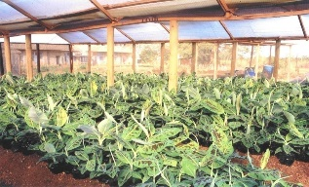
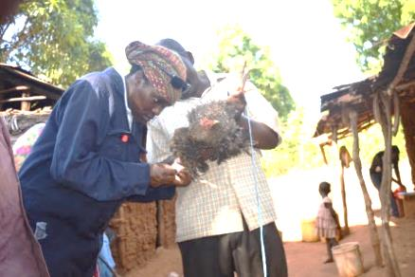
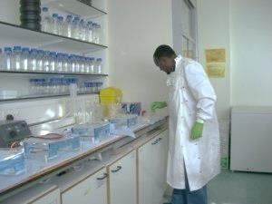
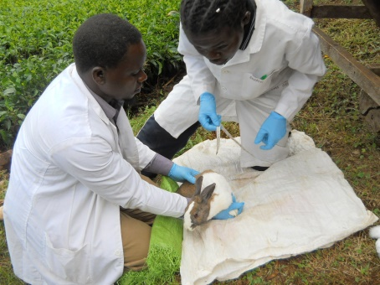
Capacity building | Quantity
PhD. | 4
MSc. | 2
Other Key Performance Indicators | Quantity
Publications in peer reviewed journal and conference proceedings | 9 (1 nature)
Number of products developed | 2
PRODUCTS
Tissue culture banana seedlings growing in a greenhouse in JKUAT
JKUAT researcher examining indigenous chicken reared for genetic traits
The lead researcher on rhino DNA markers at work
Students collecting data on a rabbit

Slide 36
IEET (KES: 235.2m )
Sub-theme 1
Sub-theme 2
RENEWABLE ENERGIES
ENVIRONMENT
Solar Energy
Mini-Hydros
Environmental audits
Waste management
Biomas
Solar wind hybrids
Climate change
Trainings
Training
Occupational safety and health

Slide 37
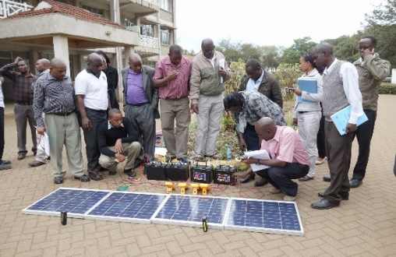
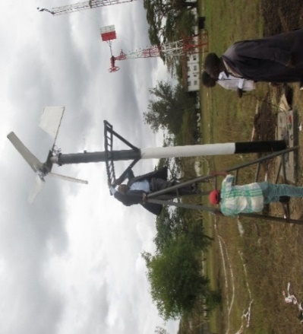
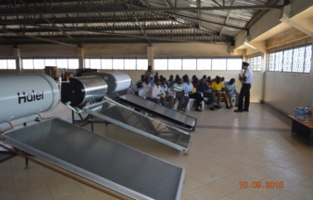
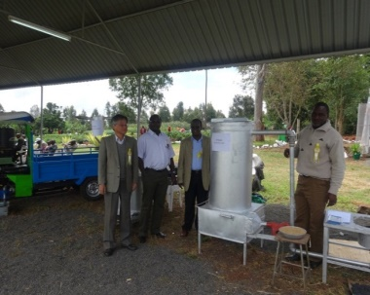
Capacity building | Quantity
PhD. | 13
MSc. | 70
Technicians | 1380
Other Key Performance Indicators | Quantity
Publications in peer reviewed journal and Conference proceedings | 112
Number of products developed | 10
Products patented (Applied) | 2
Infrastructural development | 6
PRODUCTS
Solar training practical session
Installation of a 200W wind-turbine electricity generator at Saint Xavier Girls’ Secondary School
Factory visit by IEET Solar Water heating trainees at Steelstone Ltd.(Nairobi)
JKUAT researchers at the Nyeri ASK show exhibiting a rice husk gasifier

Slide 38
Eco-Housing.
Reclaimed Asphalt Concrete.
Stabilized soil Blocks,
Biodiversity studies.
Floristic investigation.
genomics.
Fog Harvesting.
SRI promotion.
Groundwater Risk Management.
Bathymetric Reservoir Survey
Breeding
Storage & value addition,
Nutrition and health.
SMARTEC
SAJOREC
WARREC
LCEFONS

Slide 39
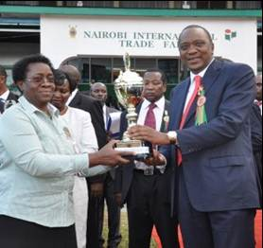
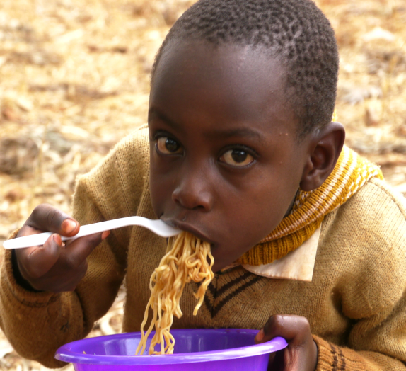
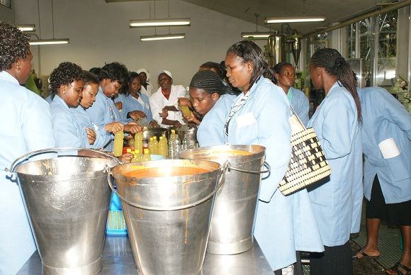
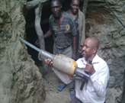





Extension and Technology Transfer Activities (359.5 m)
shows
Nissin Noodles
Trainings
Social Studies
Radio and TV
Promotion Material
Dairy, Cow Milk, value chain studies

Slide 40















THE JKUAT TECH EXPO .

Slide 41
THE JKUAT TECH EXPO .
ORIGINATING COMPANIES
Innovation | output
IDAKTARI | Medical Services Digitization Platform
MOBILE GAMING SOLUTION | Software for Mobile Gaming
CORE CENTRE | Remote management of client services via a call center
PLASTO BRICKS | Composite construction materials from plastic wastes and sand
TAMARILO Products | Food grade Flavours from Tree Tomato

Slide 42

UNIVERSITY LINKAGES
Universities
National Institutions
Private sector
KALRO
GERMANY
SAFARICOM
NRF
CANADA
Real IPM
KEMRI
FLORALIFE
JAPAN
SIEMENS AG
DEVELOMENT PARTNERS
LINE MINISTRIES
USAID
Agric.
CIDA
DFID
JKUAT
Health
EU
DAAD
SIDA
GIZ
MoE
Industrialization

Slide 43
CONCLUSIONS
Research and innovation culture in JKUAT has just began;
There is a long way to go before a research-based competence that generates innovations and new technologies that contribute to prosperity is achieved;
Innovation is not a sudden flash of inspiration, but a long process of experimenting and learning and therefore must be carefully managed at all stages in order to deliver useful results;
The aim is develop an ecosystem of research and innovation culture where the university is interacting with stakeholders so that research and innovation products can turned into new businesses.

Slide 44
THE FUTURE
THE ENTREPRENEUR UNIVERSITY CONCEPT
  Technologies moved from Lab. to the Market
    Through Licensing
    Encouraging inventors to start business from their innovations (SPIN -OFFS)
University Contribution
Establish enabling Facilities e.g.( iLABS, wet-LABS, incubators).
Establish Venture capital funds

Slide 45
FUTURE :-Venture Capitals Examples
UNIVERSITY | YEAR | Value (m)
CAMBRIDGE -UK | 2013 | £ 50
University of California | 2014 | $ 250
Oxford ISIS | 2015 | £ 300
University College London | 2016 | £ 50
JKUAT Should Follow this Example

Slide 46
FUTURE-Focus
Universities | Startups
University of Cambridge UK | Life sciences
University of Munich | Mobile technology
University of Zurich -Swiss | Computing Technologies
Aalto University (Finland) | Energy and design
Copenhagen and Malmo- Sweden | Life Sciences

Slide 47
FUTURE- JKUAT Focus
AREAS TO FOCUS ON
Mobile Technologies
Renewable energies
Computing and information technologies
Life Sciences

Slide 48
FUTURE- SPIN-OFFS
Income from Spin-off and Licensing
EXAMPLES: Oxford ISIS got £ 54.6 million in 2015 Harvard got $16.1 m form 14 firms created from their own technologies in 2015 This income goes back to fund research but relatively small compared to her 2015 budgets ( $ 4.5 Billion) Spin-off and licensing are mainly for creating impacts

Slide 49

ISIS innovation ltd., University of Oxford

Slide 50
PARTING SHOT
"New frontiers of the mind are before us, and if they are pioneered with the same vision, boldness, and drive with which we have waged this war we can create a fuller and more fruitful employment and a fuller and more fruitful life."--
FRANKLIN D. ROOSEVELT
November 17, 1944.

Slide 51
ACKNOWLEDGEMENT
JKUAT University Council
JKUAT Chancellor
Vice Chancellor
RPE Staff
Entire JKUAT Community
JKUAT Researchers and Innovators
JKUAT Students Body esp. Tech. Expo.
JKUAT Development Partner; NACOSTI and International Donors

Slide 52
THANK YOU

